Slide 1

How to Spot a Scam VPN

Slide 2

Our Organization
Security Matters (SecM) is an NGO that aims to improve the digital and physical security of at-risk groups in Southeast Asia by:
Promoting digital security awareness;
Establishing a regional initiative as the first point of contact for security threats;
Providing a first responder and resource center;
Developing localized resources to address unique threats.
Notes:
Through these efforts, SecM seeks to enhance the safety and security of at-risk groups in the region.

Slide 3
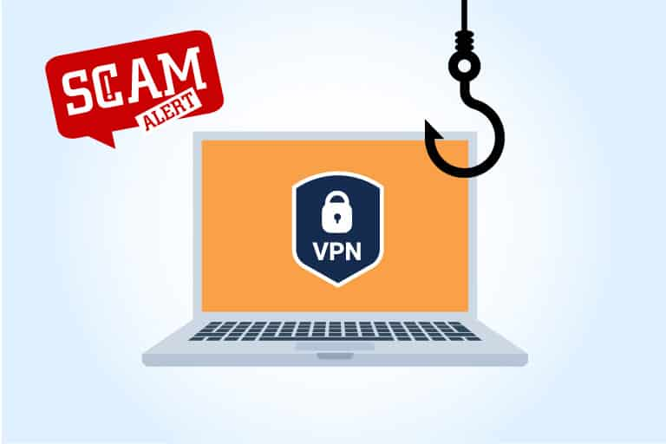
How to Spot a Scam VPN
Virtual private networks (VPNs) are crucial for online privacy and security.
Beware of scam VPNs that can compromise your data.
Recognize the red flags to make informed decisions.
Safeguard your privacy by selecting a trustworthy VPN provider.

Slide 4
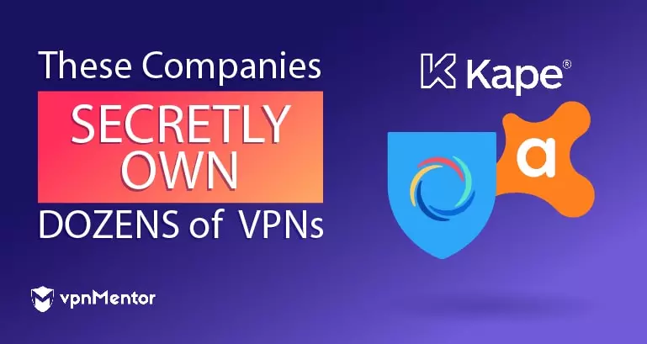
How to Spot a Scam VPN
https://www.vpnmentor.com/blog/companies-secretly-own-dozens-vpns/
Lack of Transparency
If a VPN provider is not transparent about its company information, ownership, or location, it could be a warning sign. Legitimate VPN services typically provide clear and easily accessible information about their company.

Slide 5
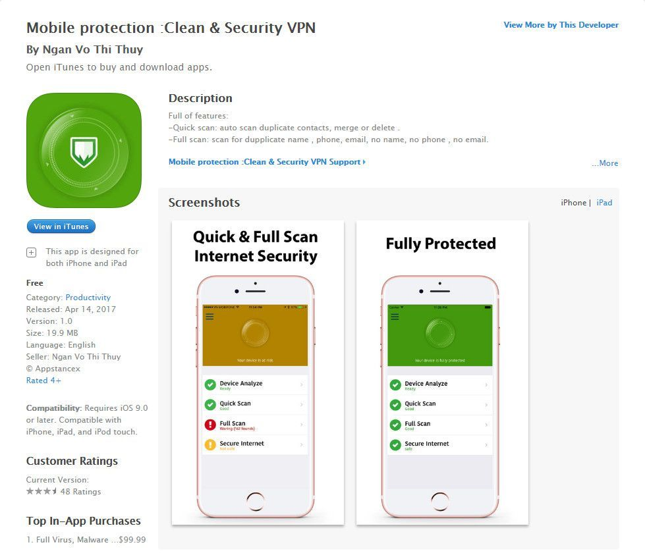
How to Spot a Scam VPN
Suspicious Pricing
Be cautious of VPN services that offer extremely low prices or lifetime subscriptions. Such offers may be too good to be true and could indicate a scam. Quality VPN services require infrastructure and ongoing maintenance, which usually come at a reasonable cost.
Notes:
The Mobile Protection: Clean & Security VPN app was removed from the Apple App Store and Google Play Store in 2017 after it was revealed that the app was a scam. The app claimed to provide users with a VPN service that would protect their privacy and security, but it actually did nothing of the sort. Instead, the app was designed to collect users' personal information and sell it to third-party companies.
The app was developed by a Vietnamese company called Ngan Vo Thi Thuy. The company was able to get the app onto the App Store and Play Store by using a fake developer account. The app was also able to get positive reviews by using fake accounts.

Slide 6
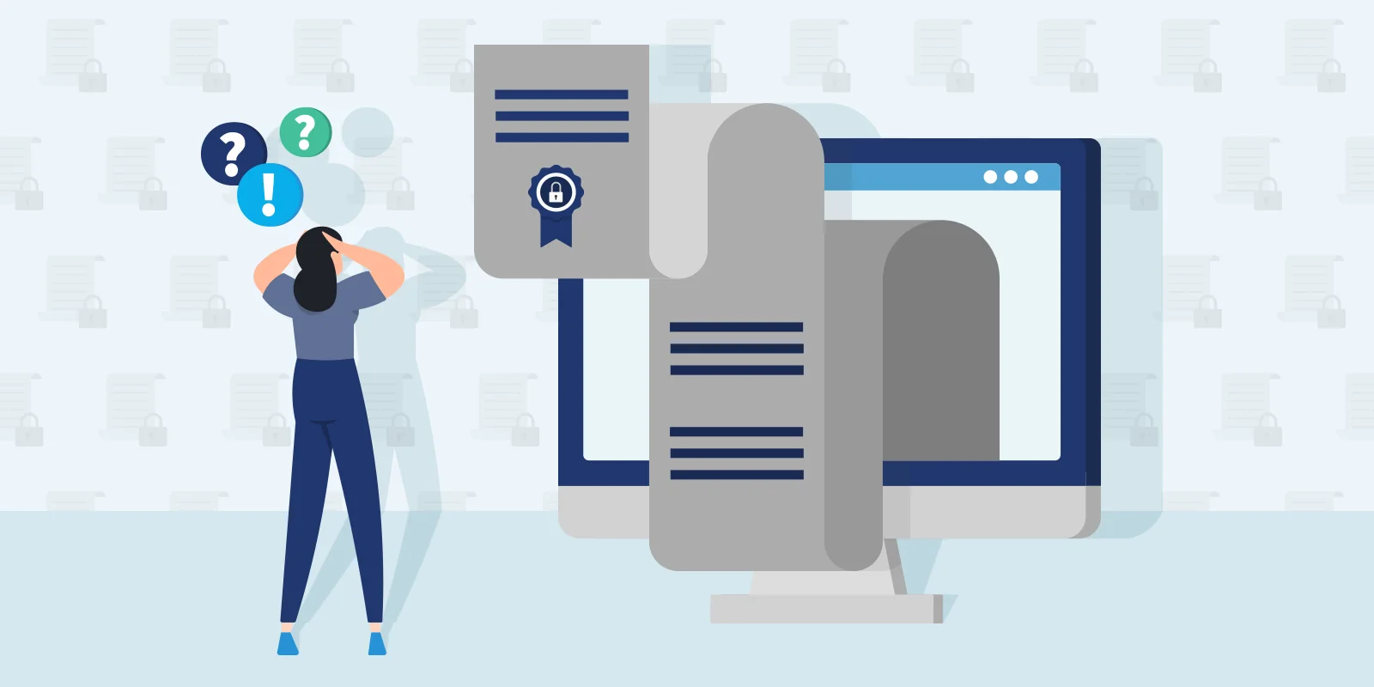
How to Spot a Scam VPN
Unclear Privacy Policy
Review the privacy policy of a VPN service before trusting it with your data. Keywords to look for:
Data collection
Data usage
Data retention
Data sharing
Encryption
Logging policy
Anonymous browsing
Jurisdiction
Transparency
Policy updates
Ensure the VPN provider has a clear and comprehensive policy on data handling and storage. Choose a reliable VPN service that does not log or share data.

Slide 7
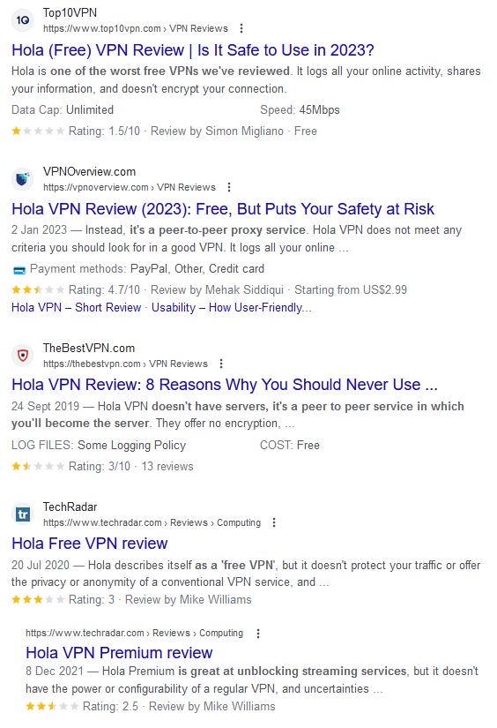
How to Spot a Scam VPN
Negative User Reviews and Ratings
Research and read reviews from reputable sources or online communities to gauge the reputation and reliability of a VPN service. If you come across multiple negative reviews or complaints regarding suspicious activities or unethical practices, it's wise to exercise caution.

Slide 8
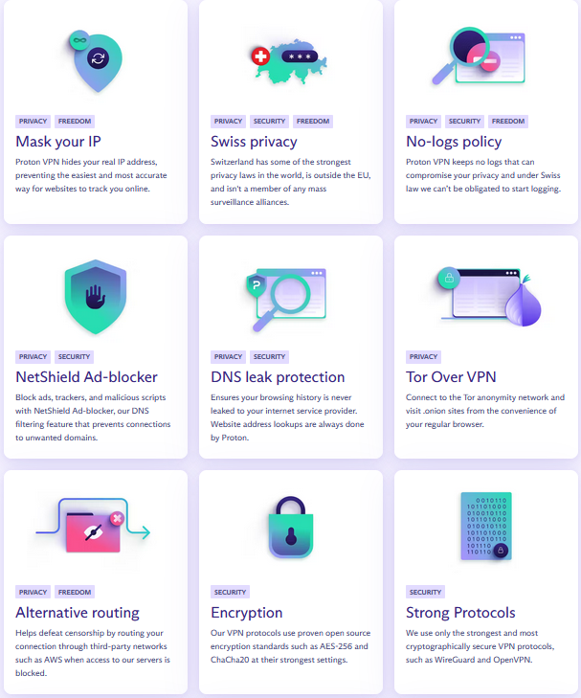
How to Spot a Scam VPN
Lack of Security Features
Some security features that top VPN service providers offer:
Strong encryption
No logs policy
Kill switch: Disconnects your internet connection if the VPN connection drops.
DNS leak protection: Prevents your DNS requests from being leaked to your ISP, reviewing your real IP address.
If a VPN provider lacks these essential elements or fails to provide detailed information about their security measures, it may be a sign of an unreliable service.

Slide 9
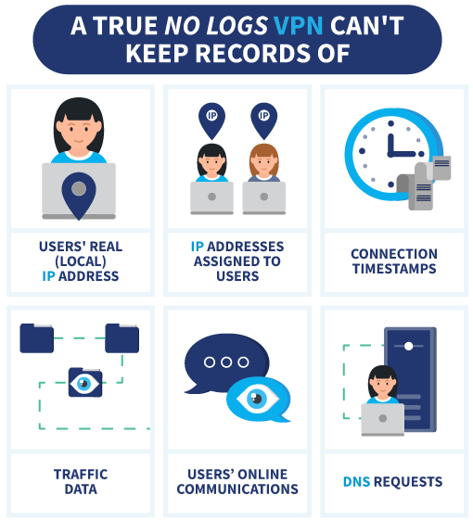
How to Spot a Scam VPN
Data Logging
Data logging is the practice of VPN service providers recording and storing user data.
Some VPN providers, especially free VPNs, may sell logged data to third parties for profit.
Reputable VPN services often claim a "no-log policy," which means that they do not store any user data.

Slide 10
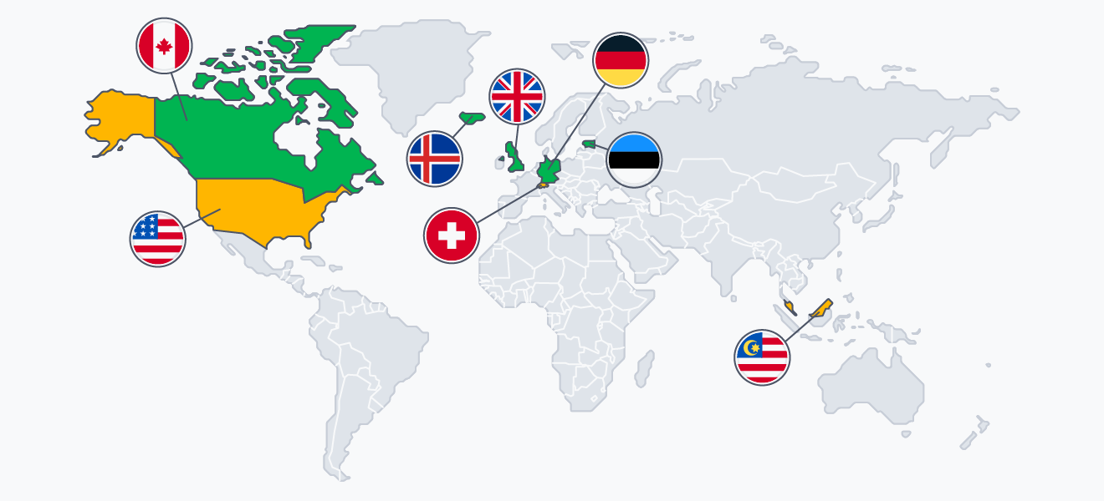
How to Spot a Scam VPN
Limited and Suspicious Server Locations
VPN offer a variety of server locations for users to choose from.
It is crucial to be aware of which VPN server locations to avoid to ensure privacy and security.
Countries with strict internet censorship, like China, may only allow government-approved VPNs, which can compromise user privacy.
Avoid using VPNs in countries such as North Korea and Russia, where VPN usage can pose risks due to surveillance and data tracking.
Notes:
PureVPN and HideMyAss still do not publicly disclose which servers in their network are virtual and which are physical.

Slide 11
THANK YOU!
Question?
Email us at:
info@securitymatters.asia
Or
Text us on WhatsApp or Signal: +60 16-298 2046
@secm8
@sec_matters

